Slide 1
SOLAR POWER GENERATION PROJECT
Done By: GROUP 3
Darshana Mahajan
Atharva Pawar
Akash RT
Gurram Saisuchitra
Paladugu.Venkata Bhanu Priyanka
Nakirikanti Naga Tejaswini

Slide 2

InTRODUCTION
Solar power generation is the process of converting sunlight into electricity using solar panels.
This Project Focuses on leveraging Machine learning techniques to predict solar power generation using the entered Data.
Solar power generation, in the context of regression analysis, involves predicting the amount of electricity produced by solar panels based on various environmental and operational factors such as temperature, solar noon distance, wind speed, and humidity.

Slide 3
OBJECTIVES
To develop a regression model for predicting solar energy production based on environmental variables.
To Build a Machine Learning Model for accurate solar power prediction.
Enhance prediction errors using advanced ML techniques.
Provide a scalable and reliable tool for energy forecasting.
Analyze the relationship between environmental factors (e.g., temperature, humidity, solar radiation) and energy production.

Slide 4

TOOLS AND LIBRARIES
Data Manipulation
1.Numpy
2.Pandas
Data Visualization
3. Matplotlib
4. Seaborn
Data preprocessing
5. Standard Scaler
5.Train Test Split
Model Building
1.Scikit-learn
Model Evaluation
2. Scikit-learn
Model Deployment
3.Pickle
4.Streamlit
5.Css

Slide 5
EDA
Data Cleaning
Renaming column name etc.
Handling Missing Values
Data Visualization
EDA
Outliers Detection and Treatment
Encoding
Feature Scaling

Slide 6
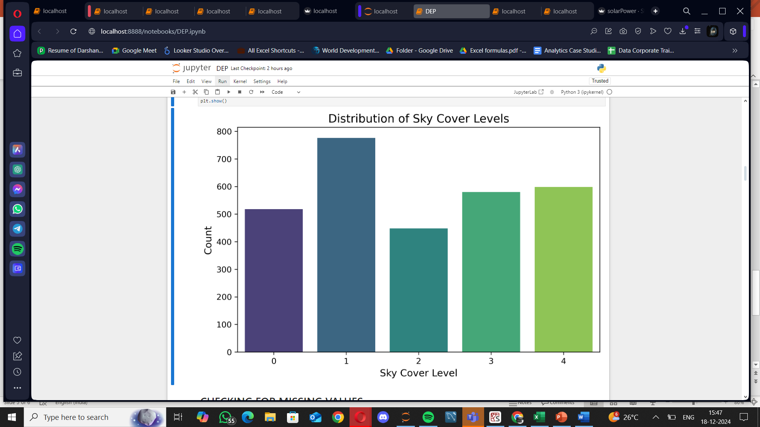
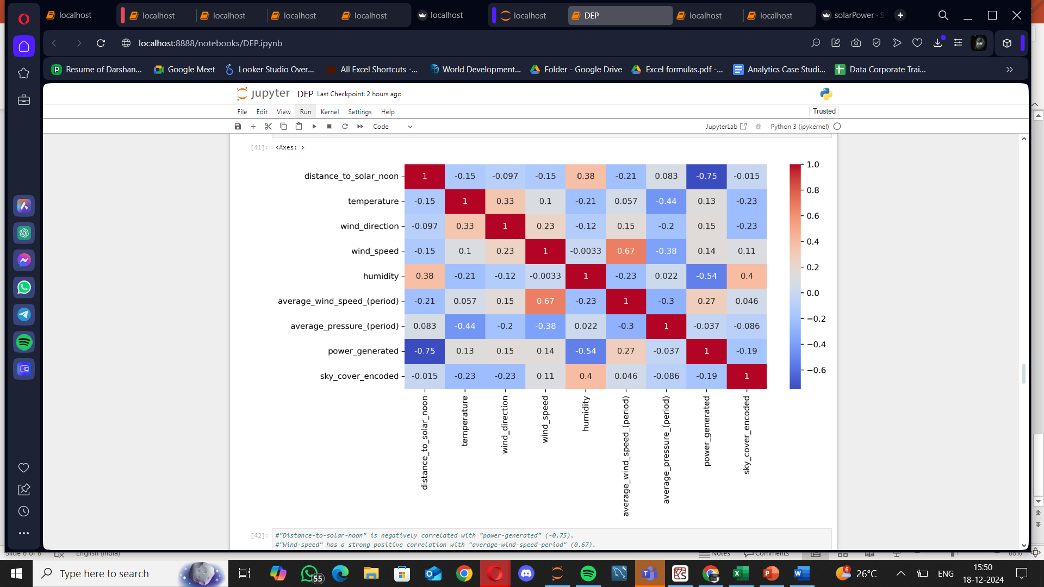
Data VISUALIZATION
COUNTPLOT
HEATMAP
0: Clear , 1: Few Clouds , 2 : Partly Cloudy , 3 : Mostly Cloudy , 4 : Overcast
Distance to solar noon is negatively correlated with power generated (r = -0.75), while wind speed and average wind speed period have a strong positive correlation (r = 0.67).

Slide 7
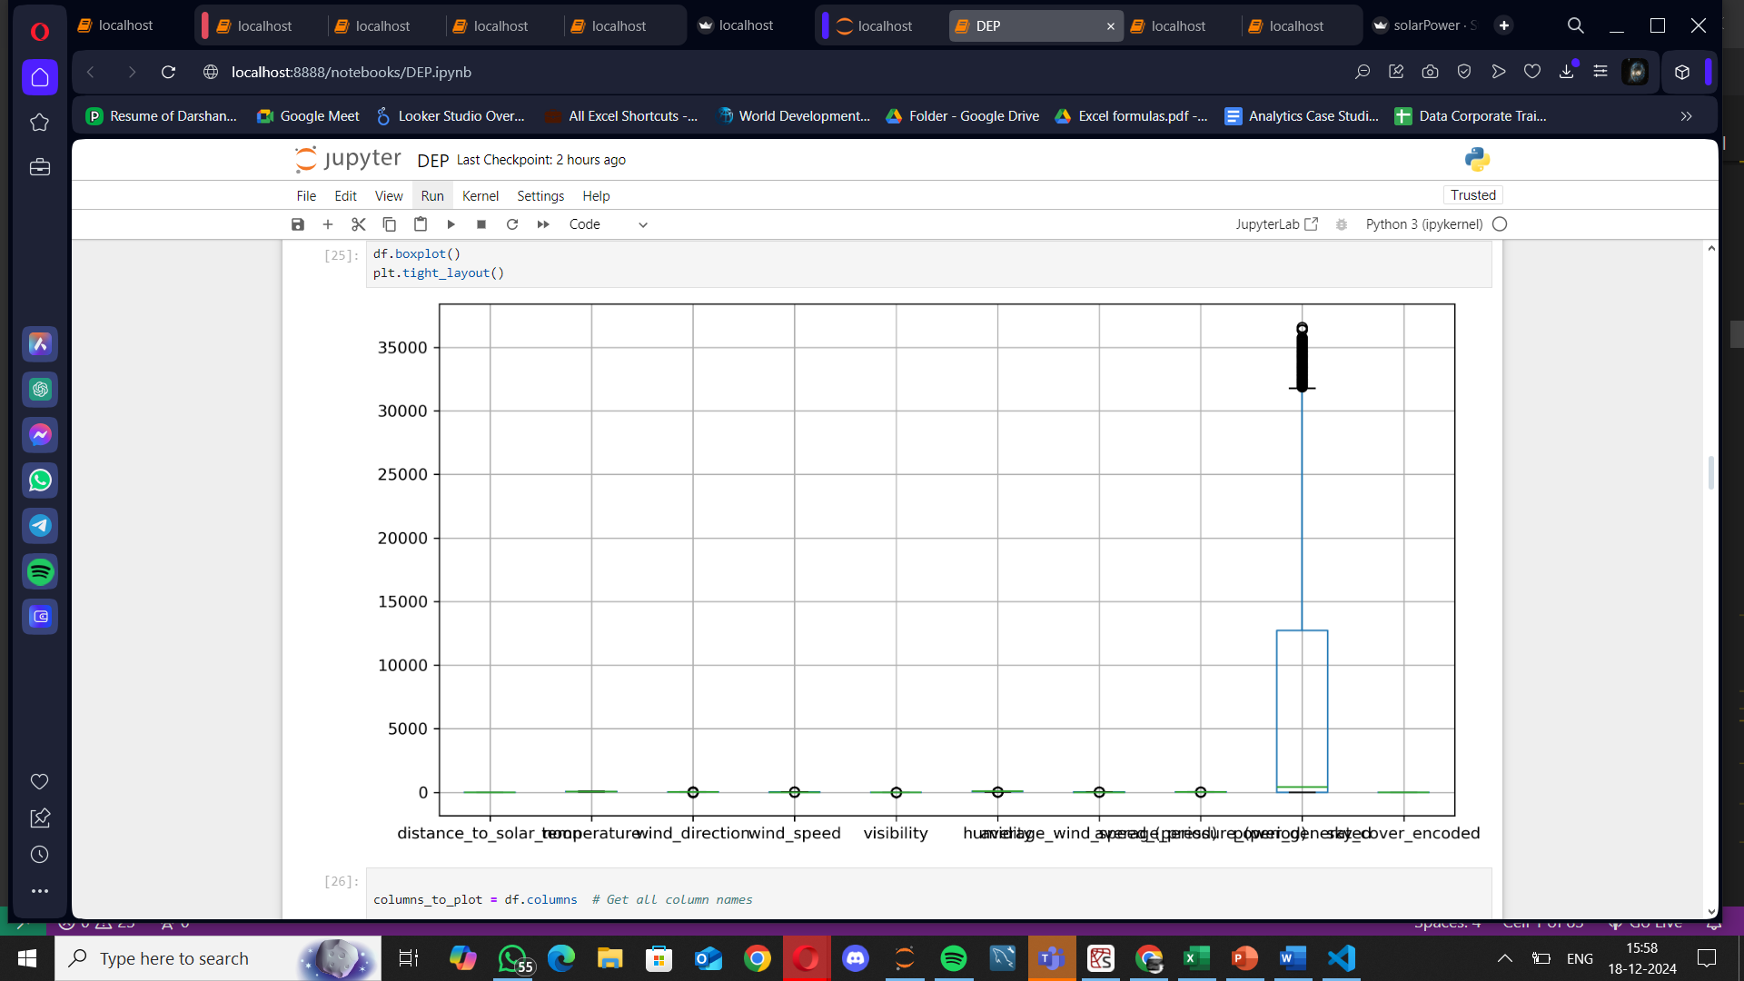
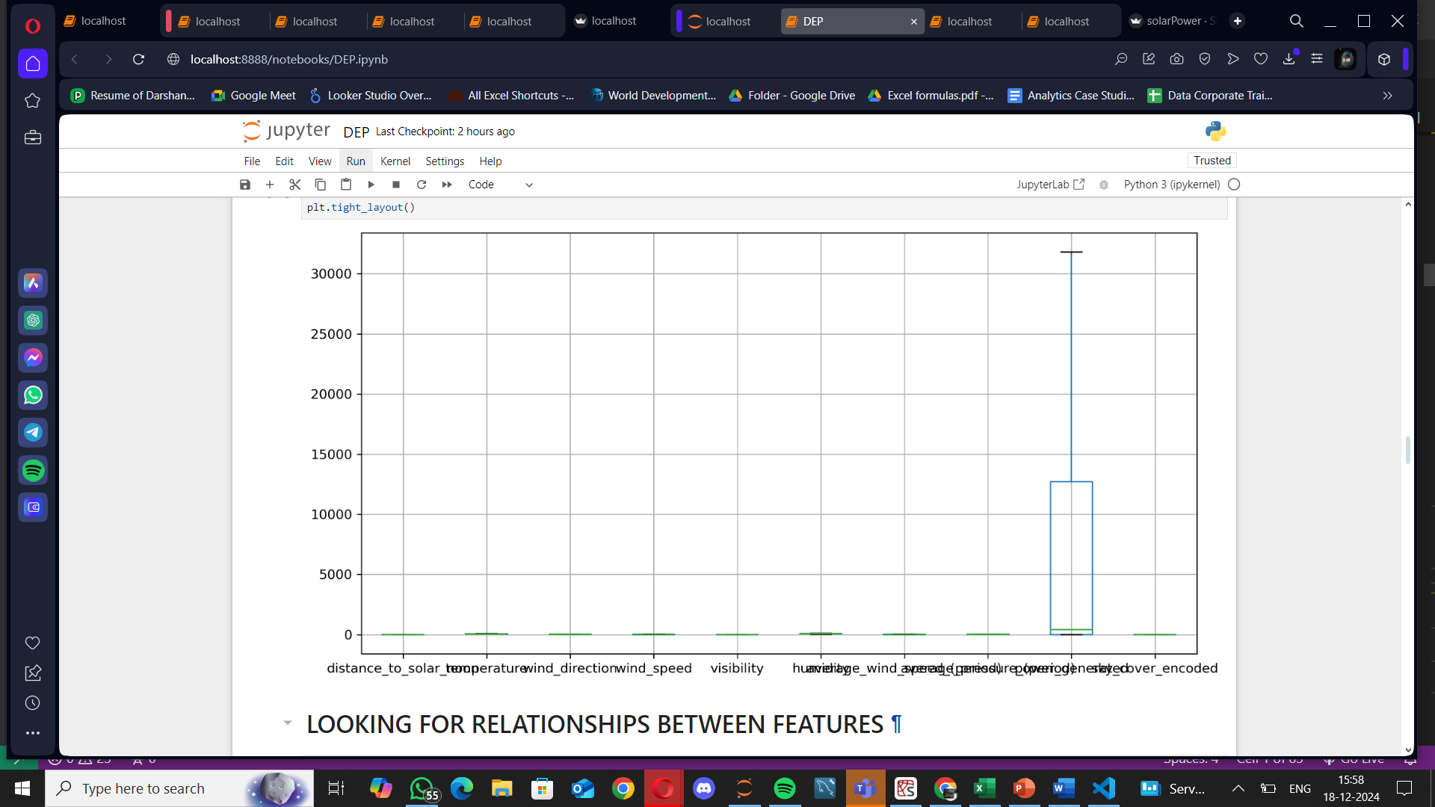
BOXPLOT
IQR
BOXPLOT BEFORE OUTLIERS REMOVAL
BOXPLOT AFTER OUTLIERS REMOVAL

Slide 8
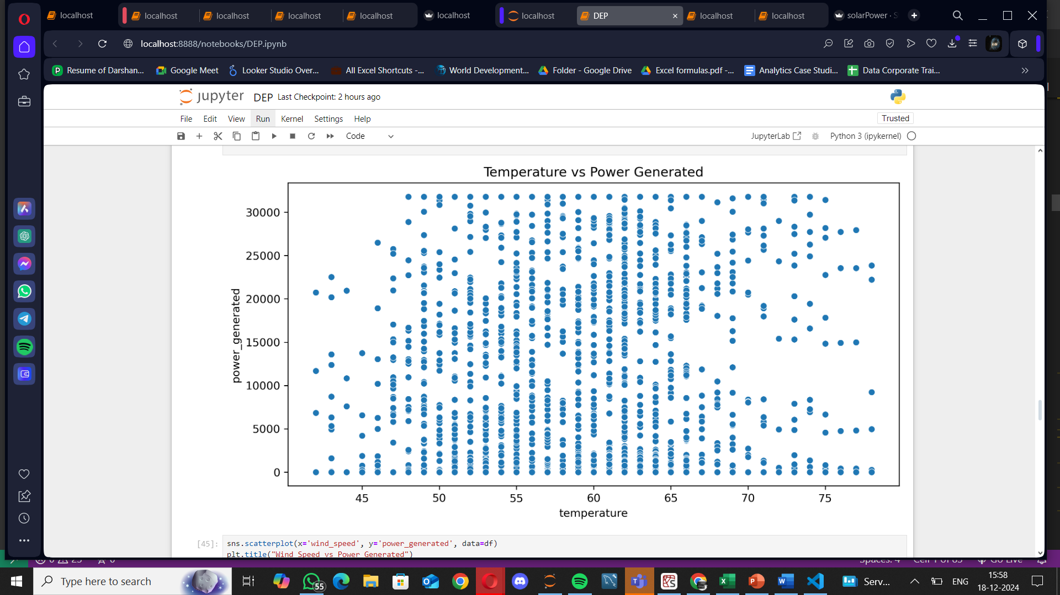
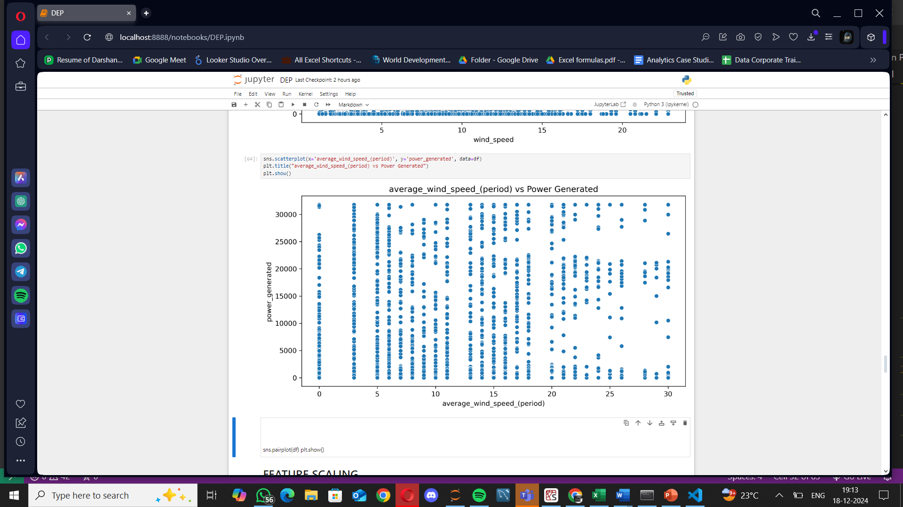
The scatter plot shows a positive correlation between average wind speed and power generated, with a noticeable reduction in power generation observed after wind speeds exceed approximately 20 meters per second.
SCATTER-PLOTS
The initial decrease in power generation with increasing temperature.

Slide 9
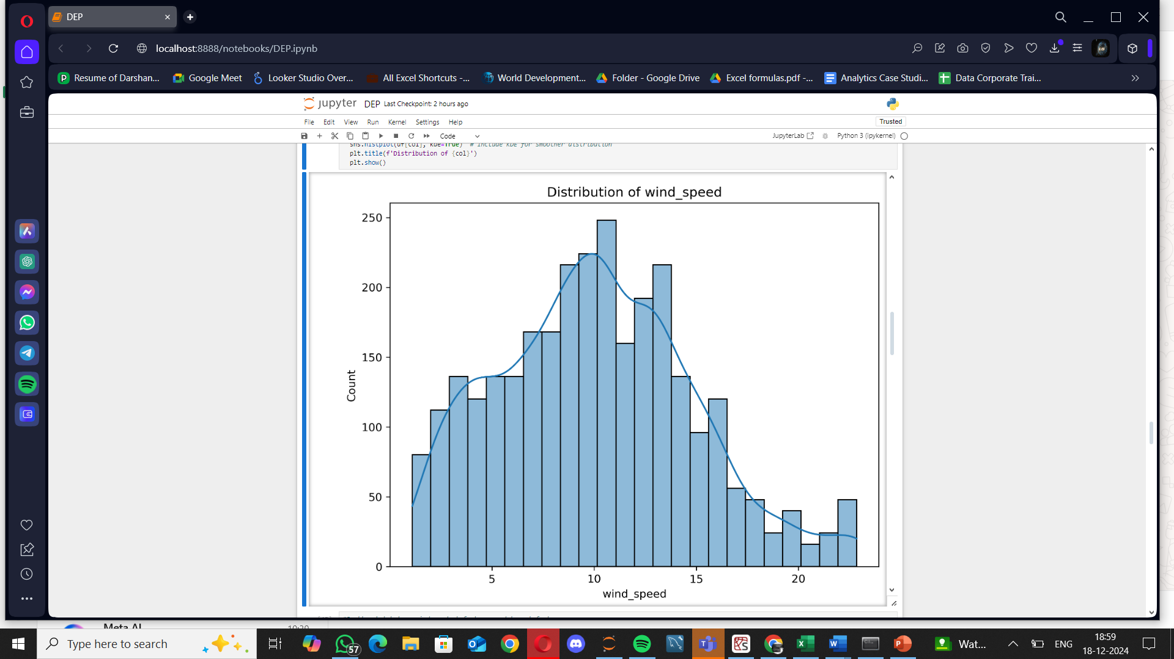
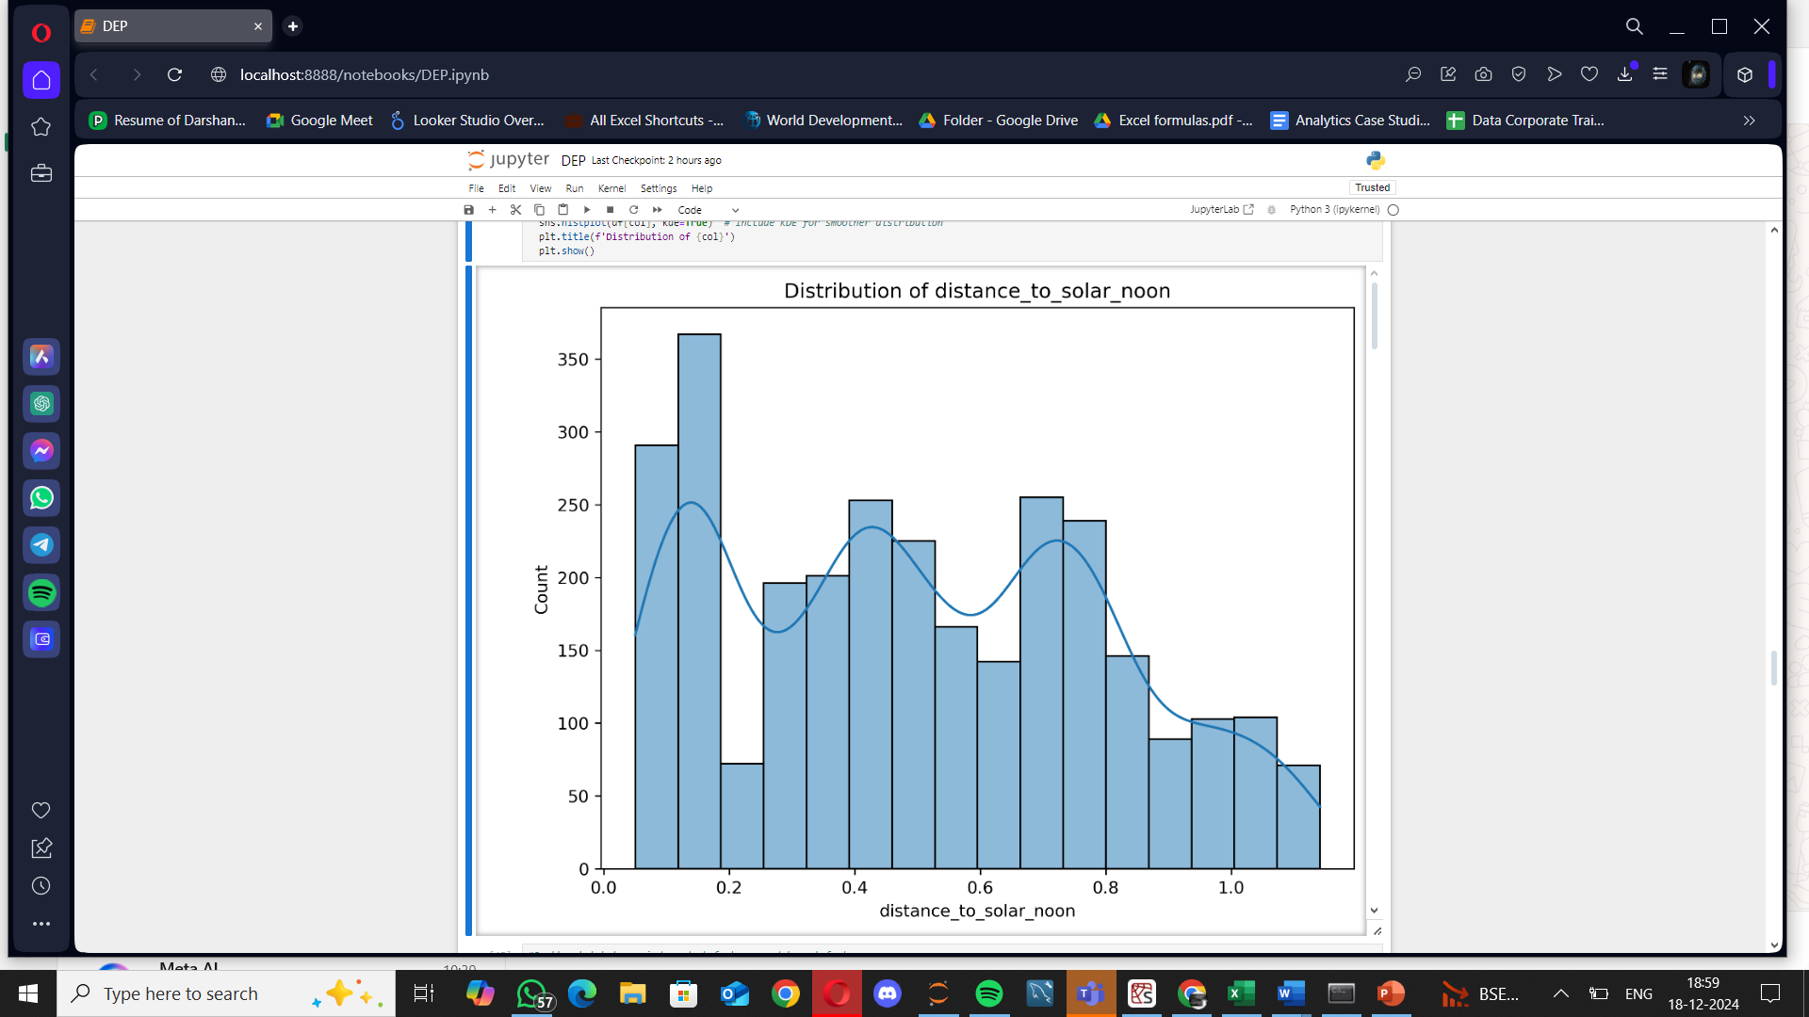
The bimodal distribution indicates that measurements
were primarily taken during two distinct periods: one close to solar noon (within about 2 hours) and another much further away (around 10 hours before or after).
HISTOGRAMS
Most of the time, the wind speed is moderate, with the highest frequency occurring between 6 and 8 meters per seconds.

Slide 10
MODEL BUILDING
TESTED ON DIFFERENT MODELS:
1.LINEAR REGRESSION
2.RIDGE REGRESSION (L2 REGULARIZATION)
3.LASSO REGRESSION (L1 REGULARIZATION)
4.DECISION TREE REGRESSOR
5.RANDOM FOREST REGRESSOR
6.GRADEINT BOOSTING
7.XGBoost REGRESSOR
8.XGBoost REGRESSOR WITH POLYNOMIAL FEATURES
#Gradient Boosting achieves the best R² score (0.9163) on the test set while keeping RMSE and MAE low.While XGBoost with polynomial features is close, it slightly underperforms on RMSE compared to Gradient Boosting.

Slide 11
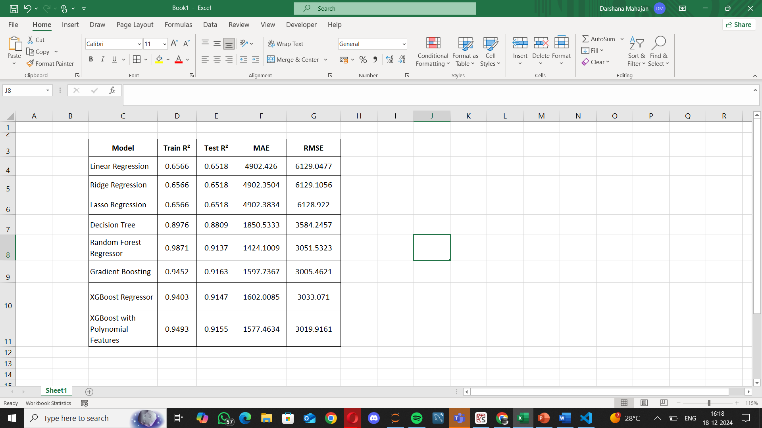
EVALUATION

Slide 12
CHALLENGES
Model Selection: Choosing the right model for the problem can be difficult, especially with many options available.
Overfitting/Underfitting: Balancing model complexity to avoid overfitting or underfitting is a common challenge.
Hyperparameter Tuning: Finding the optimal hyperparameters for models can be time-consuming and computationally expensive.
The deployment phase introduces complexities related to integration, monitoring, and compliance.

Slide 13
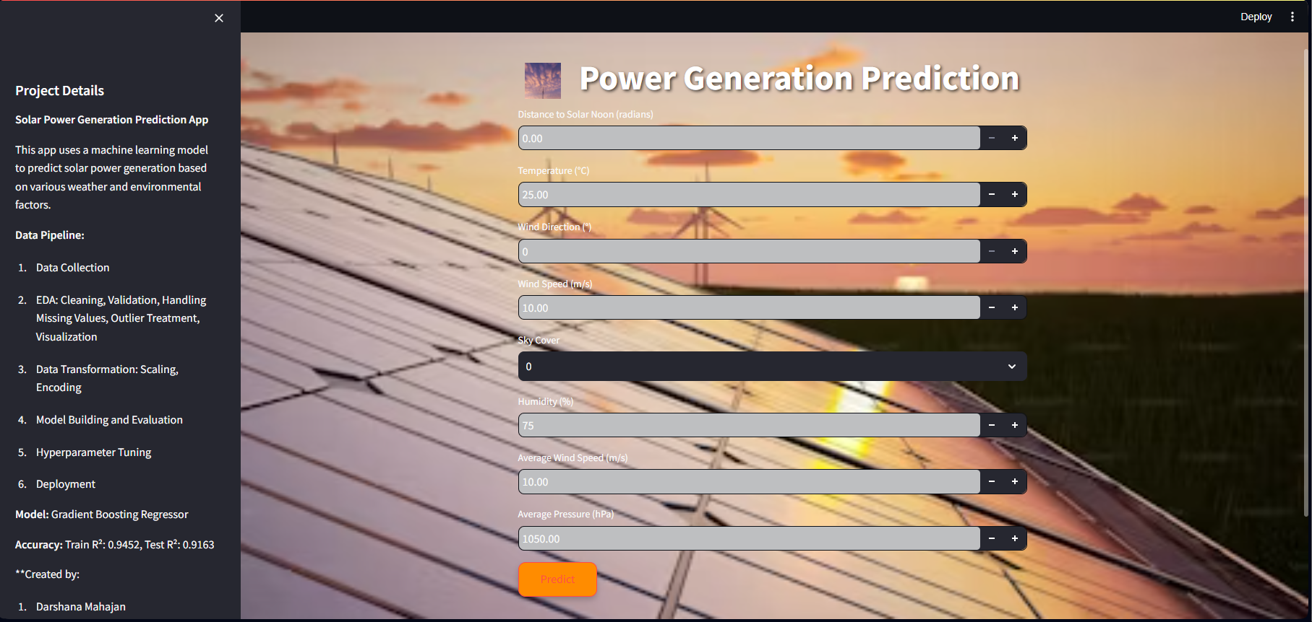
DEPLOYMENT AND STREAMLIT APP

Slide 14
CONCLUSION
The project successfully utilized gradient boosting regression, particularly XGBoost, to accurately predict solar power generation by leveraging diverse datasets.
The deployment emphasized the importance of real-time data integration for maintaining prediction accuracy.
Overall, this work contributes valuable insights to optimize solar energy management and supports advancements in renewable energy forecasting.

